Slide 1
What are Gates?
•
The building blocks that creates digital circuits are logic gates.
Each gate has its own logic symbol which allows complex functions to be represented by a logic diagram
The function of each gate can be represented by a truth table or using Boolean notation
•
•

Slide 2
LOGIC GATES
Types of gates
NOT
AND
OR
NAND
NOR
EX-OR
EX-NOR
BUFFER GATE

Slide 3
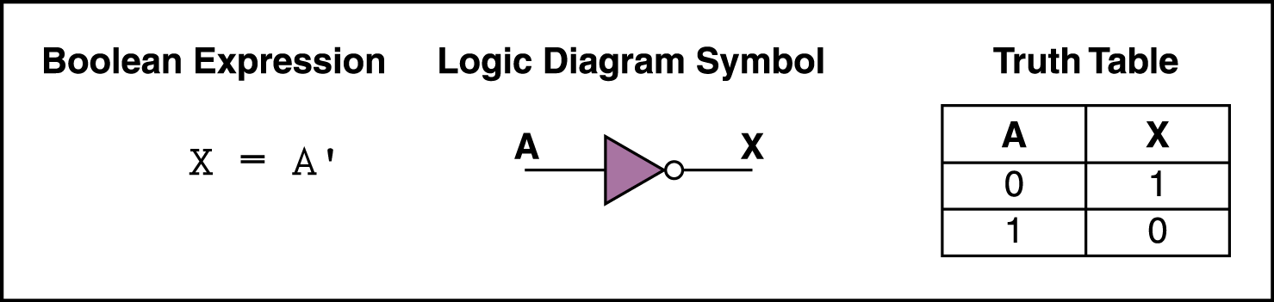
NOT Gate
•
A NOT gate accepts one input value and produces one output value
By definition, if the input value for a NOT gate is 0, the output value is 1, and if the input value is 1, the output is 0
A NOT gate is sometimes referred to as an inverter
because it inverts the input value
•
•

Slide 4
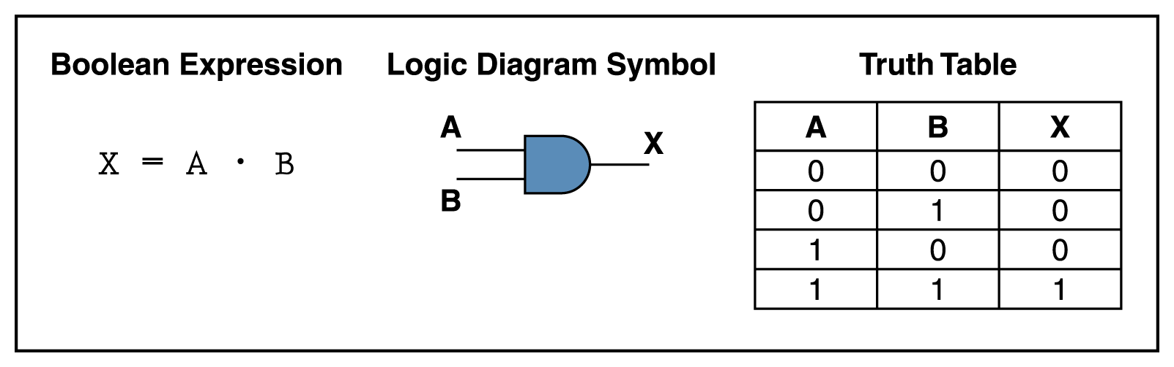
AND Gate
An AND gate accepts two input signals
If the two input values for an AND gate are both 1, the output is 1; otherwise, the output is 0

Slide 5
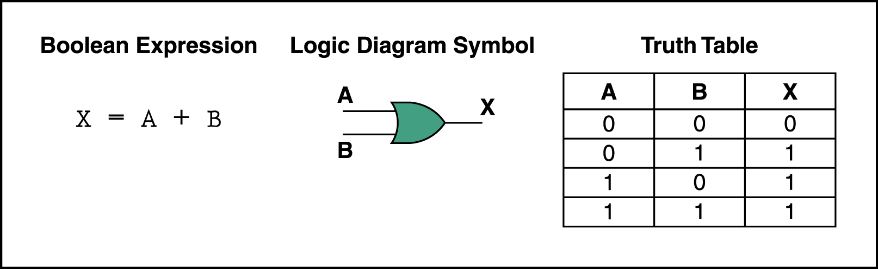
OR Gate
If the two input values are both 0, the output value is 0; otherwise, the output is 1

Slide 6
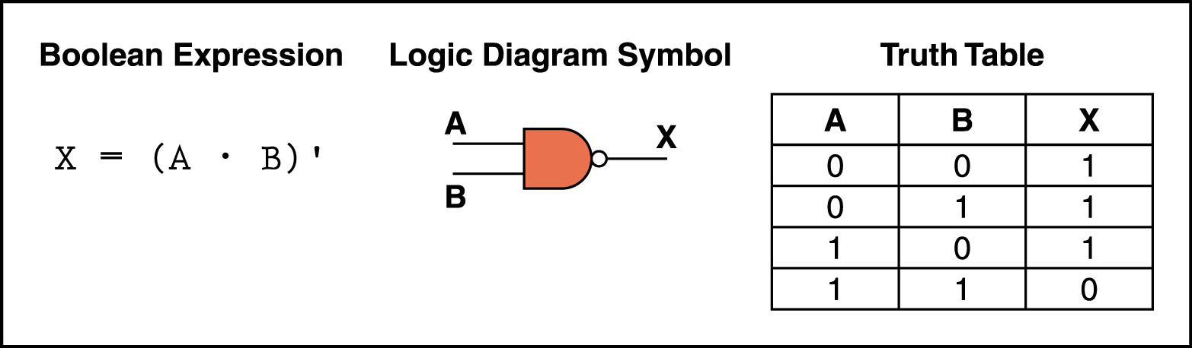
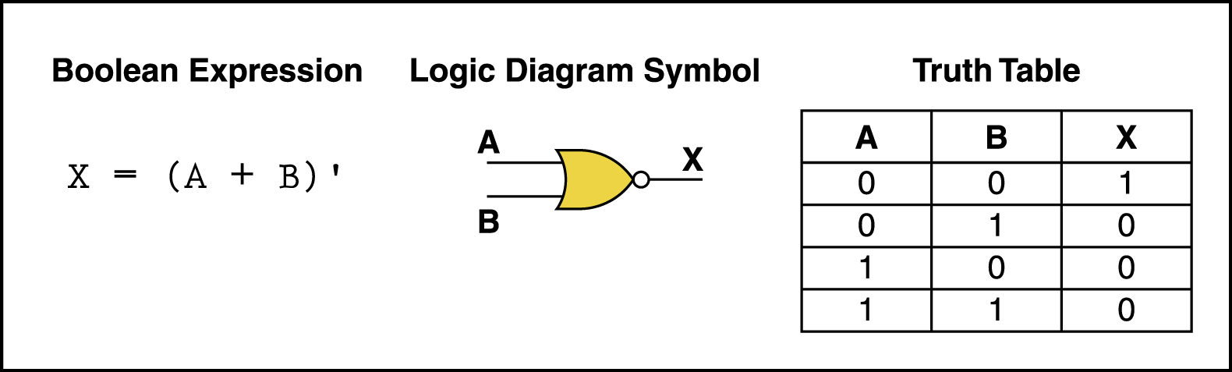
NAND and NOR Gates
The NAND and NOR gates are essentially the opposite of the AND and OR gates, respectively.
They are also called universal gates.

Slide 7
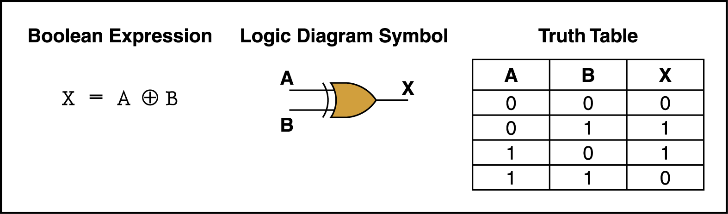
XOR Gate
XOR, or exclusive OR, gate
– An XOR gate produces 0 if its two inputs are the same, and a 1 otherwise

Slide 8
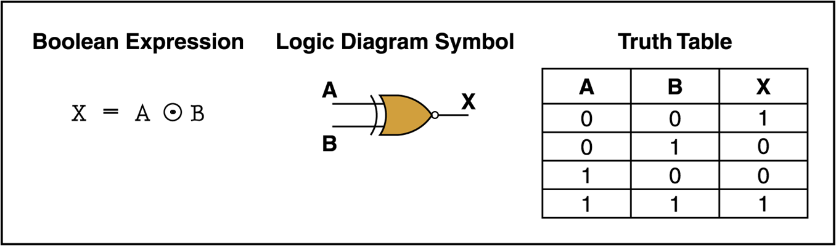
XNOR Gate
XNOR, or exclusive NOR, gate
– An XNOR gate produces 0 if its two inputs are the different, and a 1 otherwise

Slide 9
Boolean Algebra
Mathematical system, formulate logic with symbols.
Mathematics of digital system.
Algebraic Manipulation
Boolean Function
Expression using binary operators.
Bracket, NOT, AND, OR
Eg; F =x.y’.z

Slide 10
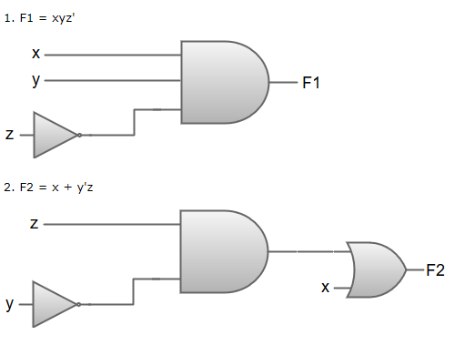
Boolean algebra simplifications using logic gates

Slide 11
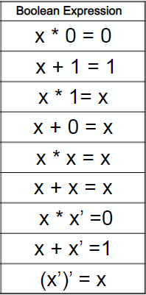
Theorems

Slide 12
Theorems
Commutative Law
It that the interchanging of the order of operands in a Boolean equation
does not change its result. For example:
OR operator → A + B = B + A
AND operator → A . B = B . A
Associative Law
It states that the AND operation are done on two or more than two variables.
For example:
A .(B.C) = (A.B).C A+(B+C) = (A+B)+C
Distributive Law
It states that the multiplication of two variables and adding the result with a
variable will result in the same value as multiplication of addition of the variable
with individual variables. For example:
A + BC = (A + B) (A + C) and A .(B+C) = AB+ AC

Slide 13
Theorems
De Morgan's Theorem
(A+B)’ = A’.B’ (A+B+C)’ = A’.B’.C’
(A.B)’ = A’+B’ (A.B.C)’ = A’+B’+C’
Duality Principle:
To find the dual of any expression:
- change the operator
- 0 > 1, 1>0
Eg: a+a’= 1 dual : a.a’=0
How to find complement?
- find dual
- complement each variable.
Eg: F= x+y 1.dual = x.y 2. F’= x’.y’

Slide 14
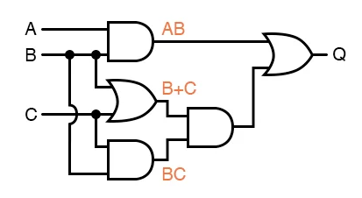
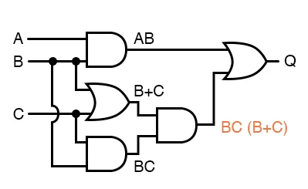
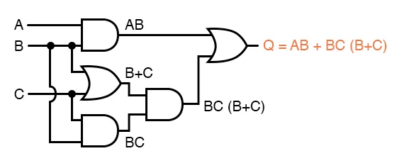
Gate Implementation
Q=A.B+B.C.(B+C)

Slide 15
Simplification of Boolean Functions
Simplify the following Boolean functions to a minimum number of literals.
x+x’.y = (x+x’).(x+y) = 1.(x+y) = (x+y)
x(x’+y) = x.x’ + xy = 0+xy = xy
x’y’z + x’yz +xy’ = x’z(y+y’) + xy’ = x’z+xy’
xy + x’z +yz = xy+yz +x’z +x.x’ = y(x+z)+x’(x+z) = (x+z)(y+x’)
(x+y)(x’+z)(y+z)
= (x+y)(x’+z)(y+z+x.x’) [x.x’ = 0]
= (x+y)(x’+z)(y+z+x) (y+z+x’) [distributive property]
= (x+y)(x’+z)(x+y+z) (x’+y+z)
Let; (x+y)=A and (x’+z)=B
= A.B.(A+z).(B+y)
= A.(A+z).B.(B+y) = A.A+A.z.BB+By = A+A.z.B+By = A(1+z).B(1+y)
= A.B
= (x+y).(x’+z)

Slide 16
Find the complement of F = x+y’z. Also prove F.F’= 0 and F+F’= 1. Implement F = xy+x’y’+yz’
using AND,OR and NOT gates
using NOT and OR only
using NOT and AND only

Slide 17
Q= A’B’+A’C+B’C’
Q= A’C+B’C’
Redundant Theorem:
3 variables
Each variable repeated twice
One variable must be complemented
Take complemented variable and remaining is redundant.
F = AB+BC’+AC = BC’+AC
F =(A+B).(A’+C).(B+C) = A+B).(A’+C)

Slide 18
Find the complement of F = x+y’z. Also prove F.F’= 0 and F+F’= 1. F’ = (x+y’z)’ = x’.(y’.z)’ = x’.(y+z’) = x’y+x’z’ To prove: F.F’=0 LHS. (X+y’z). (x’y+x’z’ ) To prove: F+F’=1 LHS. X+y’z+x’y+x’z’ = x+x’y+y’z+x’z’ = X+y+y’z+x’z’ = x+x’z’+y+y’z = A+ 1 =1 F+F’ = [(F+F’)’]’ = [(F’.F)]’ = [0]’ = 1

Slide 19
Canonical and Standard Forms
Boolean functions expressed as a sum of minterms or product of maxterms are said to be in canonical.
Minterms and Maxterms
Sum-of-Minterms and Product-of- Maxterms
Product and Sum terms
Sum-of-Products (SOP) and Product-of-Sums (POS)
No of minterms = no of maxterms = 2^{n}

Slide 20
Definitions
Literal: A variable or its complement
Product term: literals connected by •
Sum term: literals connected by +
Minterm: a product term in which all the variables appear exactly once, either complemented or uncomplemented
Maxterm: a sum term in which all the variables appear exactly once, either complemented or uncomplemented

Slide 21
Minterm
Represents exactly one combination in the truth table.
Denoted by m_{j}, where j is the decimal equivalent of the minterm’s corresponding binary combination (b_{j}).
A variable in m_{j} is complemented if its value in b_{j} is 0, otherwise is uncomplemented.
Example: Assume 3 variables (A,B,C), and j=3. Then, b_{j} = 011 and its corresponding minterm is denoted by m_{j} = A’BC

Slide 22
Maxterm
Represents exactly one combination in the truth table.
Denoted by M_{j}, where j is the decimal equivalent of the maxterm’s corresponding binary combination (b_{j}).
A variable in M_{j} is complemented if its value in b_{j} is 1, otherwise is uncomplemented.
Example: Assume 3 variables (A,B,C), and j=3. Then, b_{j} = 011 and its corresponding maxterm is denoted by M_{j} = A+B’+C’

Slide 23
Truth Table notation for Minterms and Maxterms
Minterms and Maxterms are easy to denote using a truth table.
Example: Assume 3 variables x,y,z (order is fixed)
Minterms: x=0; x’
x=1; x
And vice versa for maxterm
x | y | z |  | Minterm | Maxterm
0 | 0 | 0 |  | x’y’z’ = m₀ | x+y+z = M₀
0 | 0 | 1 |  | x’y’z = m₁ | x+y+z’ = M₁
0 | 1 | 0 |  | x’yz’ = m₂ | x+y’+z = M₂
0 | 1 | 1 |  | x’yz = m₃ | x+y’+z’= M₃
1 | 0 | 0 |  | xy’z’ = m₄ | x’+y+z = M₄
1 | 0 | 1 |  | xy’z = m₅ | x’+y+z’ = M₅
1 | 1 | 0 |  | xyz’ = m₆ | x’+y’+z = M₆
1 | 1 | 1 |  | xyz = m₇ | x’+y’+z’ = M₇

Slide 24
Canonical Forms
Any Boolean function F( ) can be expressed as a unique sum of minterms and a unique product of maxterms (under a fixed variable ordering).
In other words, every function F() has two canonical forms:
Canonical Sum-Of-Products (sum of minterms)
Canonical Product-Of-Sums (product of maxterms)

Slide 25
Canonical Forms (cont.)
Canonical Sum-Of-Products: The minterms included are those m_{j} such that F( ) = 1 in row j of the truth table for F( ).
Canonical Product-Of-Sums: The maxterms included are those M_{j} such that F( ) = 0 in row j of the truth table for F( ).

Slide 26
Example
Truth table for f₁(a,b,c) at right
The canonical sum-of-products form for f₁ is f₁(a,b,c) = m₁ + m₂ + m₄ + m₆ = a’b’c + a’bc’ + ab’c’ + abc’
The canonical product-of-sums form for f₁ is f₁(a,b,c) = M₀ • M₃ • M₅ • M₇ = (a+b+c)•(a+b’+c’)• (a’+b+c’)•(a’+b’+c’).
Observe that: m_{j} = M_{j}’
a | b | c |  | f₁
0 | 0 | 0 |  | 0
0 | 0 | 1 |  | 1
0 | 1 | 0 |  | 1
0 | 1 | 1 |  | 0
1 | 0 | 0 |  | 1
1 | 0 | 1 |  | 0
1 | 1 | 0 |  | 1
1 | 1 | 1 |  | 0

Slide 27
Shorthand: ∑ and ∏
f₁(a,b,c) = ∑ m(1,2,4,6), where ∑ indicates that this is a sum-of-products form, and m(1,2,4,6) indicates that the minterms to be included are m₁, m₂, m₄, and m₆.
f₁(a,b,c) = ∏ M(0,3,5,7), where ∏ indicates that this is a product-of-sums form, and M(0,3,5,7) indicates that the maxterms to be included are M₀, M₃, M₅, and M₇.
Since m_{j} = M_{j}’ for any j, ∑ m(1,2,4,6) = ∏ M(0,3,5,7) = f₁(a,b,c)

Slide 28
Conversion Between Canonical Forms
Replace ∑ with ∏ (or vice versa) and replace those j’s that appeared in the original form with those that do not.
Example: f₁(a,b,c) = a’b’c + a’bc’ + ab’c’ + abc’ = m₁ + m₂ + m₄ + m₆ = ∑(1,2,4,6) = ∏(0,3,5,7) = (a+b+c)•(a+b’+c’)•(a’+b+c’)•(a’+b’+c’)

Slide 29
Conversion to SOP
Expand non-canonical terms by inserting equivalent of 1 in each missing variable x: (x + x’) = 1
Remove duplicate minterms
f₁(a,b,c) = a’b’c + bc’ + ac’ = a’b’c + (a+a’)bc’ + a(b+b’)c’ = a’b’c + abc’ + a’bc’ + abc’ + ab’c’ = a’b’c + abc’ + a’bc + ab’c’

Slide 30
Conversion to POS
Expand noncanonical terms by adding 0 in terms of missing variables (e.g., xx’ = 0) and using the distributive law
Remove duplicate maxterms
f₁(a,b,c) = (a+b+c)•(b’+c’)•(a’+c’) = (a+b+c)•(aa’+b’+c’)•(a’+bb’+c’) = (a+b+c)•(a+b’+c’)•(a’+b’+c’)• (a’+b+c’)•(a’+b’+c’) = (a+b+c)•(a+b’+c’)•(a’+b’+c’)•(a’+b+c’)

Slide 31
F(A,B,C)=A+B’C
For SOP conversion;
F=A+B’C
F=A(B+B’)(C+C’)+B’C(A+A’)
F= (AB+AB’)(C+C’)+ AB’C+A’B’C
F= ABC + ABC’ + AB’C + AB’C’ + AB’C+A’B’C
F= ABC + ABC’ + AB’C + AB’C’ +A’B’C
F = ∑ m(….)

Slide 32
F(A,B,C)=A+B’C
For POS conversion;
F=A+B’C
F=(A+B’).(A+C) [ Similar to POS]
F = (A+B’+C.C’).(A+B.B’+C)
F= (A+B’+C).(A+B’+C’).(A+B+C).(A+B’+C)
F= (A+B’+C).(A+B’+C’).(A+B+C)
F = ∏ M(...)

